Slide 1
Data base system
Nasreen Akhtar
FAST-NU
Chiniot Faisalabad Campus

Slide 2
Objectives
How to use SQL to create tables, indexes, and views.
How to use SQL for data manipulation (to Insert , modify, delete, and retrieve data)
How to use SQL to query a database to extract useful information

Slide 3
Join
SQL Join is used to fetch data from two or more tables, which is joined to appear as single set of data.
Using values common to both tables
To perform join, include more than one table in FROM clause.
Use comma as separator and typically include WHERE clause to specify join column(s).
Also possible to use an alias for a table named in FROM clause.
Alias is separated from table name with a space.
Alias can be used to qualify column names when there is ambiguity

Slide 4
Join
Example “List all orders, showing the order number and amount, and the name and credit limit of the customer who placed it.”
The four specific data items requested are clearly stored in two different tables
The ORDERS table contains the order number and amount of each order, but doesn’t have customer names or credit limits.
The CUSTOMERS table contains the customer names and balances, but it lacks any information about orders.

Slide 5
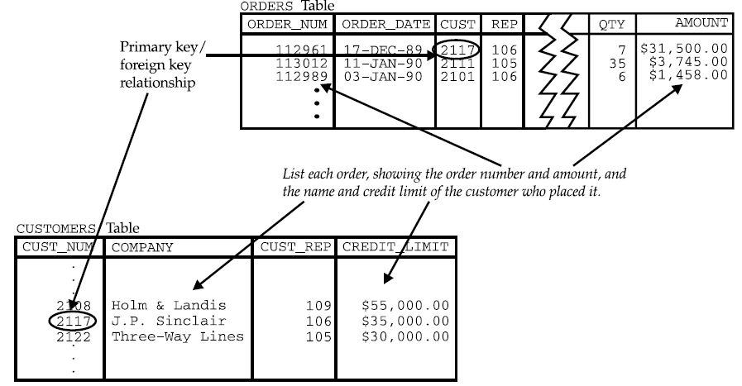
Join

Slide 6
Types of Join
Cross joins
Inner join
outer joins
Left Outer Join
Right Outer Join
Full Outer Join

Slide 7
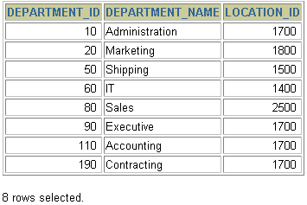


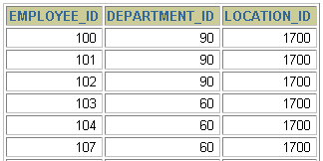
Cartesian join
A Cartesian product is formed when:
A join condition is omitted
All rows in the first table are joined to all rows in the second table
To avoid a Cartesian product, always include a valid join condition.
Example
Select Employee_Id, Departemnt_ID, Location_ID
From EMPLOYEE
Cross join DEPARTMENT;
DEPARTMENTS (8 rows)
EMPLOYEES (20 rows)
…
Cartesian product: 20 x 8 = 160 rows

Slide 8
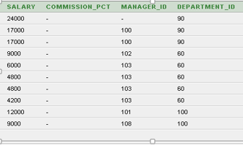
INNER OR EQUI JOIN
This is a simple JOIN in which the result is based on matched data as per the equality condition specified in the query.
Example
Select * From employees ,departments
Where employees.department_id=departments.department_id;

Slide 9
INNER OR EQUI JOIN
The process of forming pairs of rows by matching the contents of related columns is called joining the tables.
The resulting table (containing data from both of the original tables) is called a join between the two tables. (A join based on an exact match between two columns is more precisely called an equi-join)
EXAMPLE SELECT ORDER_NUM, AMOUNT, COMPANY, CREDIT_LIMIT
FROM ORDERS, CUSTOMERS
WHERE CUST = CUST_NUM

Slide 10
INNER OR EQUI JOIN
Equi join Based On Row Selection Criteria SELECT CITY, NAME, TITLE FROM OFFICES, SALESREPS WHERE MGR = EMPL_NUM AND TARGET > 600000.00

Slide 11
INNER OR EQUI JOIN
Query with three or more tables SELECT ORDER_NUM, AMOUNT, COMPANY, NAME FROM ORDERS, CUSTOMERS, SALESREPS WHERE CUST = CUST_NUM AND REP = EMPL_NUM AND AMOUNT > 25000.00

Slide 12
Self Join
Some multi table queries involve a relationship that a table has with itself.
For example, suppose you want to list the names of all salespeople and their managers. Each salesperson appears as a row in the SALESREPS table, and the MANAGER column contains the employee number of the salesperson’s manager. It would appear that the MANAGER column should be a foreign key for the table that holds data about managers. In fact it is—it’s a foreign key for the SALESREPS table itself

Slide 13
Self Join
SELECT EMPS.NAME, MGRS.NAME
FROM SALESREPS EMPS, SALESREPS MGRS
WHERE EMPS.MANAGER = MGRS.EMPL_NUM

Slide 14
Self Join
Find the customer from the same city
SELECT B.FirstName AS FirstName1, B.LastName AS LastName1,
A.FirstName AS FirstName2, A.LastName AS LastName2,
B.City, B.Country
FROM Customer A, Customer B
WHERE A.Id <> B.Id
AND A.City = B.City
AND A.Country = B.Country
ORDER BY A.Country

Slide 15
Outer Join
Outer Join is based on both matched and unmatched data.
With an inner join, if one row of a table is unmatched, row is omitted from result table.
The outer join operations retain rows that do not satisfy the join condition.
There are three types of OUTER JOIN
Left Outer Join
Right Outer Join
Full Outer Join
Lets discuss inner join then we will come back to outer join.
Query execution (Performance) is much better than other joins

Slide 16
Outer Join
Inner join of departments and lecturers tables will result in the following output.
Lid
Lname
dno
salary
dno
dname
1
Ahmed
1
4000
1
ICS
2
Amin
2
3700
2
COE
SELECT a.*, b.*
FROM lecturers a,
Departments b
WHERE a.dno = b.dno
3
Hani
1
4200
1
ICS
4
Ageel
1
4000
1
ICS
5
Yousef
2
3500
2
COE
6
Khalid
2
4500
2
COE

Slide 17
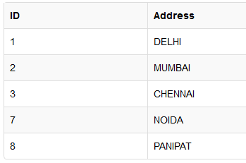
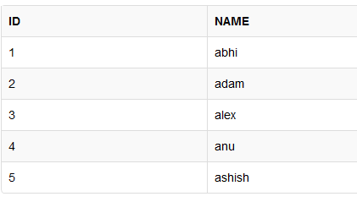
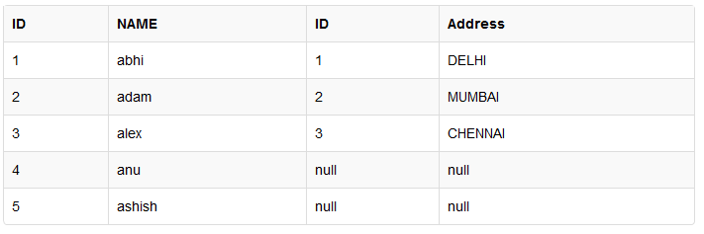
Left outer join
Return only matched value
Remaining row of left table and NULL value to the right table.
Select * from class left outer join class_info ON(class.ID=class_info.ID);
class
Class_info

Slide 18
Left Outer Join
If We want to Include in the output table the lecturers whose department is unknow we rewrite our previous query as follows
Lid
Lname
dno
salary
dno
dname
1
Ahmed
1
4000
1
SE
2
Amin
2
3700
2
SWE
3
Hani
1
4200
1
ICS
5
Ageel
1
4000
1
SWE
SELECT a.*, b.*
FROM lecturers a,
Departments b
WHERE a.dno = b.dno(+)
6
Yousef
2
3500
2
COE
7
Khalid
2
4500
2
COE
4
Addella
4300

Slide 19
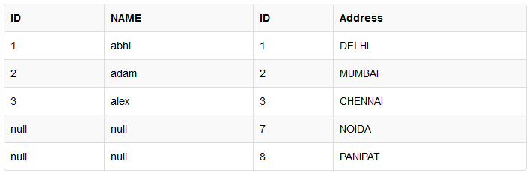
Right outer Join
The right outer join returns a result table with the matched data of two tables
remaining rows of the right table and null for the left table's columns.
Select * from class right outer join class_info ON(class.ID=class_info.ID)

Slide 20
Right outer Join
If We want to Include in the output table the departments with no lecturers we rewrite our previous query as follows
Lid
Lname
dno
salary
dno
dname
1
Ahmed
4
4000
4
SE
2
Amin
3
3700
3
SWE
3
Hani
1
4200
1
ICS
5
Ageel
3
4000
3
SWE
6
Yousef
2
3500
2
COE
7
Khalid
2
4500
2
COE
SELECT a.*, b.*
FROM lecturers a,
Departments b
WHERE a.dno (+) = b.dno
5
NW

Slide 21
Full Outer Join
If We want to Include in the output table the departments with no lecturers and the lecturers with unknow departments we rewrite our previous query as follows
Lid
Lname
dno
salary
dno
dname
1
Ahmed
4
4000
4
SE
2
Amin
3
3700
3
SWE
3
Hani
1
4200
1
ICS
5
Ageel
3
4000
3
SWE
6
Yousef
2
3500
2
COE
SELECT a.*, b.*
FROM lecturers a,
Departments b
WHERE a.dno (+) = b.dno
UNION
SELECT a.*, b.*
FROM lecturers a,
Departments b
WHERE a.dno= b.dno (+);
7
Khalid
2
4500
2
COE
5
NW
4
Abdella
4300

Slide 22
Characteristics of OUTER join
Left Outer Join:
Includes those rows of first (left) table unmatched with rows from second (right) table.
Columns from second table are filled with NULLs.
Right outer Join :
includes those rows of second (right) table that are unmatched with rows from first (left) table.
Columns from first table are filled with NULLs.
Full Outer Join:
Is the UNION of both left and right outer joins.

Slide 23
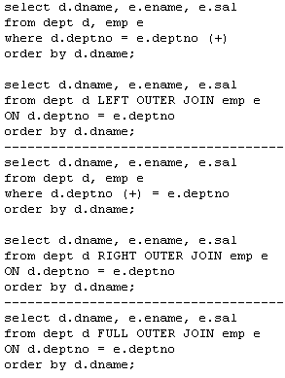

Slide 24
Union, Intersection and Difference
UNION OPERATOR
The SQL UNION operator is used to combine the result sets of 2 or more SELECT statements. It removes duplicate rows between the various SELECT statements.
Each SELECT statement within the UNION must have the same number of fields in the result sets with similar data types
UNION ALL does not remove duplicate rows.
SELECT supplier_id FROM suppliers UNION SELECT supplier_id FROM orders ORDER BY supplier_id;

Slide 25
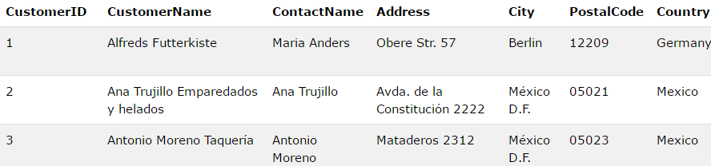
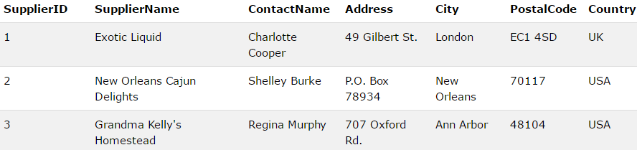
SELECT City, Country FROM Customers WHERE Country='Germany' UNION ALL SELECT City, Country FROM Suppliers WHERE Country='Germany' ORDER BY City;

Slide 26
List all the ICS and COE faculty salaries. Remove duplicates

Slide 27
List all the ICS and COE faculty salaries. Remove duplicates
SELECT salary
FROM lecturers
WHERE dno =
( SELECT dno
FROM departments
WHERE dname= ‘ICS’
)
UNION
SELECT salary
FROM lecturers
WHERE dno =
( SELECT dno
FROM departments
WHERE dname= ‘COE’
)

Slide 28
List all the ICS and COE faculty salaries. Include duplicates

Slide 29
SELECT salary
FROM lecturers
WHERE dno =
( SELECT dno
FROM departments
WHERE dname= ‘ICS’
)
UNION ALL
SELECT salary
FROM lecturers
WHERE dno =
( SELECT dno
FROM departments
WHERE dname= ‘COE’
)

Slide 30
Difference
List salaries that are taken by ICS and not COE lecturers.
SELECT salary
FROM lecturers
WHERE dno = (
SELECT dno
FROM departments
where dname= ‘ICS’
)
MINUS
SELECT salary
FROM lecturers
WHERE dno = (
SELECT dno
FROM departments
WHERE dname= ‘COE’
)

Slide 31
Intersection
List salaries that are taken by both COE and ICS lecturers.
SELECT salary
FROM lecturers
WHERE dno = (
SELECT dno
FROM departments
where dname= ‘ICS’
)
INTERSECTION
SELECT salary
FROM lecturers
WHERE dno = (
SELECT dno
FROM departments
WHERE dname= ‘COE’
)
Produces result tables from both queries and creates single result table consisting of those rows that are common to both result tables.

Slide 32
DDL

Slide 33
Data Type
Basic data types
Numeric data types
Integer numbers: INTEGER, INT, and SMALLINT
Floating-point (real) numbers: FLOAT or REAL, and DOUBLE PRECISION
Character-string data types
Fixed length: CHAR(n), CHARACTER(n)
Varying length: VARCHAR(n),

Slide 34
Data Type
Boolean data type
Values of TRUE or FALSE
DATE data type
Components are YEAR, MONTH, and DAY in the form YYYY-MM-DD
Time data type
Stores a time of day like 12:30 P.M.
LOB Large Object Store complex data like image, audio video.
It is further categorize into BLOB,CLOB and NLOB.

Slide 35
User Define data type
SQL provides a CREATE TYPE statement for defining user-defined types.
Example
CREATE TYPE SALARY AS NUMERIC(8,2) FINAL;
Salary data type can be used in Create table.
CREATE TABLE EMPLOYEE(
SSN NUMBER NOT NULL,
Emp_name VARCHAR(60) NOT NULL,
DESIGNATION CHAR,
ADDRESS VARCHAR(50),
SALARY SALARY
);

Slide 36
Create Table Structure
Use one line per column (attribute) definition
Use spaces to line up attribute characteristics and constraints
Table names are capitalized
NOT NULL specification
UNIQUE specification
Primary key attributes contain both NOT NULL and UNIQUE specification
RDBMS will automatically enforce referential integrity for foreign keys

Slide 37
Constraints
NOT NULL constraint
Ensures that column does not accept nulls
UNIQUE constraint
Ensures that all values in column are unique
CREATE TABLE Persons ( P_Id int NOT NULL UNIQUE, LastName varchar(255) NOT NULL, FirstName varchar(255), Address varchar(255), City varchar(255) );

Slide 38
Create Table Structure
DEFAULT - DEFAULT constraint
The DEFAULT constraint is used to insert a default value into a column.
The default value will be added to all new records, if no other value is specified.
CREATE TABLE Persons ( P_Id int NOT NULL, LastName varchar(255) NOT NULL, FirstName varchar(255), Address varchar(255), City varchar(255) DEFAULT 'Sandnes' );

Slide 39
Create Table Structure
CHECK constraint
Validates data when attribute value is inserted
CHECK clause at the end of CREATE TABLE statement
Apply to each tuple individually
CHECK (Dept_create_date <= Mgr_start_date);
CREATE TABLE Persons ( P_Id int NOT NULL, LastName varchar(255) NOT NULL, FirstName varchar(255), Address varchar(255), City varchar(255), CHECK (P_Id>0) );

Slide 40
Create Table Structure
CREATE TABLE CD_TITLES
( COMPACT_DISC_ID INT,
CD_TITLE VARCHAR(60) NOT NULL,
IN_STOCK INT NOT NULL,
CHECK ( IN_STOCK > 0 AND IN_STOCK < 30 )
);

Slide 41
FK Constraints
Syntax
Foreign key(attribute(s) Name) References Table_Name (Attribute(s))
Id, Name, Dno DEP(Dnum,Name)
1 Null
2 Null
Create table EMP
{
id int Primary key,
Name Char not null,
Dno num,
Foreign key (Dno) References DEP(Dnum)
};

Slide 42
Create Table Structure
Cascade When this clause is used with the DROP command, a parent table can be dropped even when a child table exists.
CREATE TABLE child_table
( column1 datatype [ NULL | NOT NULL ],
column2 datatype [ NULL | NOT NULL ],
...
FOREIGN KEY (child_col1, child_col2, ... child_col_n) REFERENCES parent_table (parent_col1, parent_col2, ... parent_col_n)
ON DELETE CASCADE
[ ON UPDATE { NO ACTION | CASCADE | SET NULL | SET DEFAULT } ] );

Slide 43
CREATE TABLE supplier (
supplier_id numeric(10) not null,
supplier_name varchar(50) not null,
contact_name varchar(50),
PRIMARY KEY (supplier_id, supplier_name)
);
CREATE TABLE products (
product_id numeric(10) not null,
supplier_id numeric(10) not null,
supplier_name varchar2(50) not null,
PRIMARY KEY(product_id),
FOREIGN KEY (supplier_id, supplier_name) REFERENCES supplier(supplier_id, supplier_name)
ON DELETE CASCADE
); The cascade delete on the foreign key causes all corresponding records in the products table to be cascade deleted when a record in the supplier table is deleted, based on supplier_id and supplier_name.

Slide 44

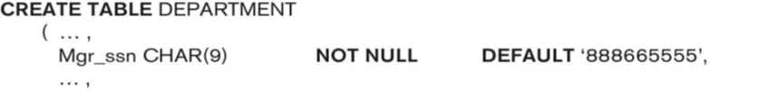

Slide 45
Create index constraints
The CREATE INDEX statement is used to create indexes in tables.
An index can be created in a table to find data more quickly and efficiently.
The users cannot see the indexes, they are just used to speed up searches/queries.
CREATE INDEX index_name ON table_name (column_name)

Slide 46



Create index constraints
The SQL statement below creates an index named "PIndex" on the "LastName" column in the "Persons" table:
CREATE INDEX PIndex ON Persons (LastName)
CREATE INDEX PIndex ON Persons (LastName, FirstName)

Slide 47
DROP DDL Commands
Drop commands delete specific Table, Index or Database, views.
The SQL DROP TABLE statement is used to remove a table definition and all data, indexes, constraints, and permission specifications for that table.
Syntax DROP TABLE table_name; Views: Drop view views_name;
DROP TABLE CUSTOMERS;
Drop index
Syntax DROP INDEX index_name ON table_name; Drop index Cindex on Customer;
DROP INDEX table_name.index_name; Drop index customer.Cindex;
Drop Database
DROP DATABASE database_name;
Drop Database Company;

Slide 48
ALTER Commands
The ALTER TABLE statement is used to add, delete, or modify columns in an existing table.
Drop
Add
Modify
SQL ALTER TABLE Syntax
To add a column in a table, use the following syntax: ALTER TABLE table_name ADD column_name datatype;
To delete a column in a table, use the following syntax (notice that some database systems don't allow deleting a column):
ALTER TABLE table_name DROP COLUMN column_name;
Alter table STD
Add column contact_no int no null;
Alter table STD
Drop column Hobby;

Slide 49
ALTER Commands
To change the data type of a column in a table, use the following syntax:
ALTER TABLE table_name MODIFY (column_name datatype);
Alter table STD
Modify Name char not null;
Notes:
ASSERTION AND TRRIGER OPEL 119

Slide 50
Class Task
EMPLOYEE
SSN int | Name char | Address char | Salary int | SuperSSN int | Dno int | No-of-child
Add column Designation and DOB in Employee table
Change data type of address to varchar
Create index SSNindex on SSN
Drop column No_of_child
Drop index SSNindex
Drop table
Notes:
ASSERTION AND TRRIGER OPEL 119

Slide 51
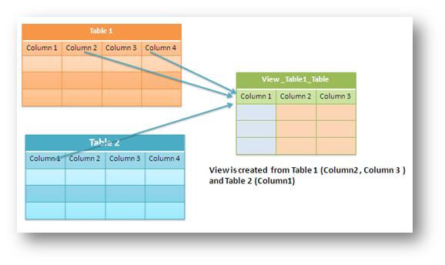
Views (DDL Command)
A view is a virtual table based on the result-set of an SQL statement.
A view contains rows and columns, just like a real table. The fields in a view are fields from one or more real tables in the database.
A View is auto updated table ( when actual tables updates views are also update)

Slide 52

Views (DDL Command)
View is Virtual relation that does not necessarily actually exist in the database but is produced upon request, at time of request.

Slide 53
Views Syntax
Create View View_Name AS
(
select statement From Clause Where condition Group by Having Condition
Order by
);

Slide 54
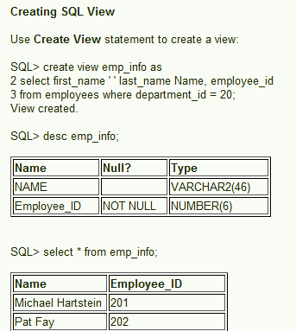
Views

Slide 55
Views (DDL Command)
Following is an example to update the age of Ramesh:
1. SQL > UPDATE CUSTOMERS_VIEW
SET AGE = 35
WHERE name='Ramesh';
2. SQL > DELETE FROM CUSTOMERS_VIEW
WHERE age = 22;
3. You need a way to drop the view if it is no longer needed.
DROP VIEW CUSTOMERS_VIEW;

Slide 56
Assertion
An assertion is merely a type of CHECK constraint that can be applied to multiple tables.
For this reason, an assertion must be created separately from a table definition.
Can be used to specify additional types of constraints that are outside the scope of the built-in relational model constraints.
To create an assertion, use the following syntax:
CREATE ASSERTION <constraint name> CHECK <search conditions>
Example of assertion DDL comand CREATE ASSERTION LIMIT_IN_STOCK
CHECK ( ( SELECT SUM (IN_STOCK) FROM CD_TITLES ) < 5000 );

Slide 57
Example
salary of an employee must not be greater than the salary of the manager of the department that the employee works for.
CREATE ASSERTION SALARY_CONSTRAINT
CHECK ( NOT EXISTS ( SELECT *
FROM EMPLOYEE E, EMPLOYEE M,
DEPARTMENT D
WHERE E.Dno=D.Dnumber
AND D.Mgr_ssn=M.Ssn )
AND E.Salary>M.Salary
);

Slide 58
Trigger
A trigger is a block structure which is fired when DML statement like Insert, Update, Delete is executed on database table. A trigger is triggered automatically when an associated DML statement is executed

Slide 59
Trigger
A procedure that starts automatically if specified changes occur to the DBMS
Triggers are invoked when you insert data into a table, update data, or delete data.
By defining one or more triggers on a table, you can specify which data-modification actions will cause the trigger to fire.
This type of functionality is generally referred to as active databases.
SQL support three type of trigger
Insert
Update
Delete

Slide 60
Trigger
Three parts:
Event (activates the trigger)
Condition (tests whether the triggers should run) [Optional]
Action (what happens if the trigger runs)
When event occurs, and condition is satisfied, the action is performed.
Events could be :
BEFORE|AFTER INSERT|UPDATE|DELETE ON <tableName>
e.g.: BEFORE INSERT ON Professor

Slide 61
Syntax
CREATE TRIGGER <trigger name>
{ BEFORE | AFTER |Instead of}
{ INSERT | DELETE | UPDATE } [ OF <column list> ]
ON <table name> [ REFERENCING <alias options> ]
[ FOR EACH { ROW | STATEMENT } ]
[ WHEN ( <search condition> ) ]
<triggered SQL statements>

Slide 62
Trigger
Assume our DB has a relation schema :
Professor (pNum, pName, salary)
We want to write a trigger that :
Ensures that any new professor inserted has salary >= 60000

Slide 63
Example 1
CREATE TRIGGER reminder1
ON Sales.Customer
AFTER INSERT, UPDATE
AS RAISERROR ('Notify Customer Relations', 16, 10);
Notes:
You may use the word
Refernceing new as newtuple and the use this word new tuple in the position where use use the word new

Slide 64
Trigger
CREATE TRIGGER minSalary BEFORE INSERT ON Professor
FOR EACH ROW
BEGIN
IF (:new.salary < 60000)
THEN RAISE_APPLICATION_ERROR (-20004, ‘Violation of Minimum Professor Salary’);
END IF;
END;

Slide 65
DCL
The SQL security scheme is based on three central concepts
Users. The actor in the database. Each time they retrieves, inserts, delete or update data.
Database Objects. The items to which SQL security protection can be applied. These objects are tables and views.
Privileges: The action that a user is permitted to carry out for a given database object. These privileges are SELECT, INSERT, DELETE AND UPDATE.
To established a security scheme for a database, you use the SLQ GRANT statement to specify which user have which privileges on which database object.

Slide 66
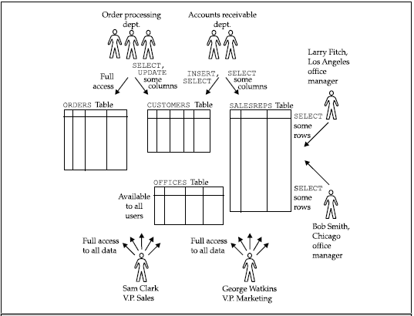
GRANT the Privileges
For example, here is a GRANT statement that lets Sam Clark retrieve and insert data in the OFFICES table of the sample database:
GRANT SELECT, INSERT
ON OFFICES
TO SAM
If you want to take away these grants then apply revoke statement
REVOKE SELECT, INSERT
ON OFFICE
FROM SAM

Slide 67
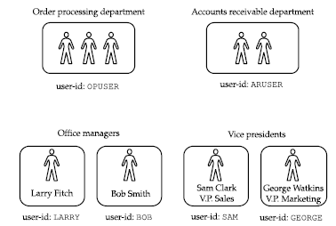
USER ID
Each user of a SQL-based database is typically assigned a user-id, to identify the user to the DBMS software.
User-id determine whether the statement will be permitted or prohibited by the DBMs.
Assigned by DBA.
Creating user syntax
Create user username identified by password;
Create user sam identified by welcome123;

Slide 68
Group of users
BUNDLE OF PRIVILIGES TO MANY USERS USE ROLE
Role define set of privileges.
Grant create session, create user, create table, insert, delete to role name;
Grant select delete update on table name to r1;
Assigned these grants to new user Grant r1 to user1,user2,user3,user4….,usern;
If a group of user perform same task the we create role for group of users.
Suppose Sam, David, Jerry are clerk so we create role for them
Create role clerk identified by login;
Now grant privileges to clerk Grant r1 to clerk;

Slide 69
Group of users
Now grant this clerks role to users like this
grant clerks to sami, scott, ashi, tanya ;
Now Sami, Scott, Ashi and Tanya have all the privileges granted on clerks role.
Suppose after one month you want grant delete on privilege on emp table all these users then just delete these privilege to clerks role and automatically all the users will have the privilege.
grant delete on emp to clerks;
If you want to take back update privilege on emp table from these users just take it back from clerks role.
revoke update on emp from clerks;
To Drop a role
Drop role clerks;
To modify role use ALTER command.
Alter role role name with attribute name;
Alter role clerk with system_clerk;

Slide 70
SQL Session
An SQL session is the connection between some sort of client application and the database.
The session provides the context in which the authorization identifier executes SQL statements during a single connection.
The session begins when you start the interactive SQL program, and it lasts until you exit the program. In an application program using programmatic SQL,
All of the SQL statements used during the session are associated with the user-id specified for the session.
Usually, you must supply both a user-id and an associated password at the beginning of a session.
Grant create session to sam;
Notes:
ALTER SYSTEM SET RESOURCE_LIMIT = TRUE;

Slide 71
GRANT statement
SQL GRANT is a command used to provide access or privileges on the database objects to the users.
Normally, the GRANT statement is used by the owner of a table or view to give other users access to the data.
GRANT SELECT, INSERT, DELETE, UPDATE
ON OREDER
TO OPUSER
Allow Sam Clark to insert or delete an office.
GRANT INSERT, DELETE
ON OFFICES
TO SAM

Slide 72
GRANTS STAMENTS
Assign all privileges to the user using ALL PRIVILEGES statements
GRANT ALL PRIVILEGES
ON SALESREPS
TO SAM
Give all users SELECT access to the OFFICES table.
GRANT SELECT
ON OFFICES
TO PUBLIC
Let order-processing users change company names and salesperson assignments.
GRANT UPDATE (COMPANY, CUST_REP)
ON CUSTOMERS
TO OPUSER

Slide 73
Give accounts receivable users read-only access to the employee number, name, and sales
office columns of the SALESREPS table.
GRANT SELECT (EMPL_NUM, NAME, REP_OFFICE)
ON SALESREPS
TO ARUSER
Passing GRANT
GRANT SELECT
ON WESTREPS
TO LARRY
WITH GRANT OPTION
Larry can now issue this GRANT statement:
GRANT SELECT
ON WESTREPS
TO SUE

Slide 74
REVOKE
The privileges that you have granted with the GRANT statement can be taken away with the REVOKE statement
A REVOKE statement may take away all or some of the privileges that you previously granted to a user-id.
Grant and then revoke some SALESREPS table privileges.
GRANT SELECT, INSERT, UPDATE
ON SALESREPS
TO ARUSER, OPUSER
REVOKE INSERT, UPDATE
ON SALESREPS
FROM OPUSER

Slide 75
Take away UPDATE and DELETE privileges for two user-ids.
REVOKE UPDATE, DELETE
ON OFFICES
FROM ARUSER, OPUSER
Take away all privileges on the OFFICES that were formerly granted to all users.
REVOKE ALL PRIVILEGES
ON OFFICES
FROM PUBLIC

